Slide 1
Lawn Wizard App
Team 10:
Kelsye Anderson - Database Specialist
Thomas Lau - Project Manager
James Seelos - Designer
Camilla Vulcano - Swiss Army Knife

Slide 2
Basic Overview of Lawn Wizard
This project aims to provide an application for customers to make finding lawn care workers stress-free and easy
Customers will be able to create jobs and post them for available workers to see
Workers will then be able to view and accept any available jobs
If there were any disputes, the Customer can submit a complaint which will then be reviewed by the Admin

Slide 3
Major Design Decisions and How They Reflected The Team’s Abilities
Working in Android Studio
Requires a lot of space and a good computer
Takes a long time to build
Easily breakable; constantly having to remove and reclone project, remaking emulators
Members knew less about Android Studio, Firebase, and Firestore
We mainly worked in teams so all the members could contribute to the project equally and we always had someone to negotiate ideas with either during meetings or outside of them
Thought it would be fun
Firebase is well organized and allows developers to see updates in real time
Navigations between pages is fun and easy to implement

Slide 4
Team Adapting to Agile Practices
Regular meetings helped productivity and encouragement within the team
This also lead us to realize the hardships and big picture of the application
It became difficult to properly care for such a big project using Android Studio

Slide 5
Requirement 1: User Authentication and Access
Functionality: User Authentication
Usability: Accessibility to user
Reliability: Verification of valid information
Performance: Quick and efficient
Supportability: Firebase/Firestore
Must Have: Firebase accessibility; email, password and name input fields
Should Have: Confirmation input fields
Could Have: Username, any additional profile info
Won’t Have this time: Profile picture on signing up

Slide 6
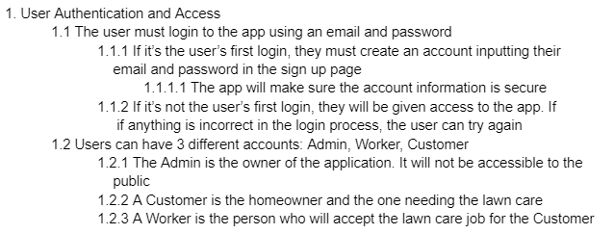
Requirement 1: User Authentication and Access - In docs folder,
In the Requirements.pdf, you can find our requirements for User Authentication and Access

Slide 7
Requirement 1: User Authentication and Access - Scrum Tasks and Unit Testing
Scrum Tasks That Went Into Development and Which Members Did It
Create database and authentication - Kelsye
Add login abilities - Camila
Implement user connection to database - Kelsye
Add Navigation - Camila and Tom
Front end design - James
Unit Testing Procedures
Trial and error while watching Firebase in real time
Testing application to handle errors

Slide 8
Requirement 2: User Profile
Functionality: Displaying user information
Usability: Connection to jobs
Reliability: Info saved to firebase for security; displays accurate info
Performance: Quick displays
Supportability: Maintains accuracy
Must Have: User’s name, location, and balance
Should Have: Profile picture
Could Have: Rating system (for all users)
Won’t Have this time: Username (in case of wanting to be anonymous)

Slide 9
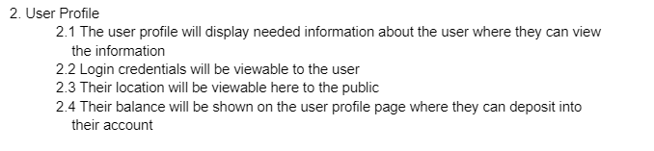
Requirement 2: User Profile - In docs folder,
In the Requirements.pdf, you can find our requirements for User Profile

Slide 10
Requirement 2: User Profile - Scrum Tasks and Unit Testing
Scrum Tasks That Went Into Development and Which Members Did It
Front end design - James
Displaying user information - James
Getting and displaying location - Tom
Functionality for funds - Kelsye
Add navigation in and out of profile - Camila
Explain relevant unit testing procedures
Trial and error with receiving data from Firebase
Throwing errors if profile fails to display

Slide 11
Requirement 3: Creation of a Job
Functionality: Adding a job for Worker’s to view
Usability: First connection between Customer and Worker
Reliability: Job info saved to Firebase
Performance: Quick and easy process to follow
Supportability: Stores job and user information for future reference
Must Have: Location, Payment, Job Description
Should Have: Customer Name
Could Have: Photo of Lawn
Won’t Have this time: Limit to which workers can view job

Slide 12
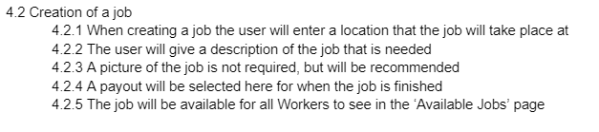
Requirement 3: Creation of a Job - In docs folder,
In the Requirements.pdf, you can find our requirements for Creation of a Job

Slide 13
Requirement 3: Creation of a Job - Scrum Tasks and Unit Testing
Scrum Tasks That Went Into Development and Which Members Did It
Front end design - James
Back end Job Model - Kelsye, Camila, Tom
Access to location - Tom
Connection to database - Kelsye and Camila
Image URI functionality - Kelsye
Explain relevant unit testing procedures
Using debugger to gain information on accessible job elements
Watching Firebase in real time to verify job is saving

Slide 14

User Creates Account Screen Capture

Slide 15
Customer Creates Job

Slide 16
Worker Accepts a Job

Slide 17
Worker Submits the Job is Done

Slide 18
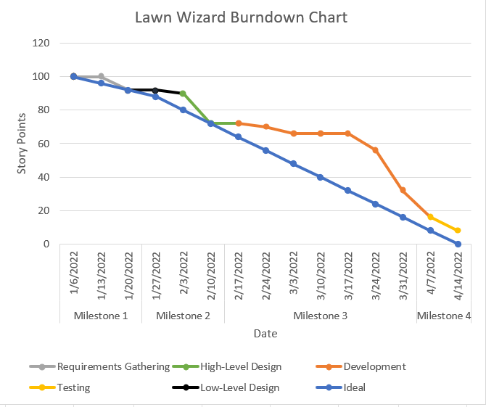
Burndown Chart

Slide 19
Resources and Citations
The color system. Material design. (n.d.). Retrieved from https://material.io/design/color/the-color-system.html
Geocoder : android developers. Android Developers. (n.d.). Retrieved from https://developer.android.com/reference/android/location/Geocoder
How to fix "Sdk location not found" in Android Studio? GeeksforGeeks. (2021, May 5). Retrieved from https://www.geeksforgeeks.org/how-to-fix-sdk-location-not-found-in-android-studio/
Install Android studio : Android developers. Android Developers. (n.d.). Retrieved from https://developer.android.com/studio/install
Ratingbar : android developers. Android Developers. (n.d.). Retrieved from https://developer.android.com/reference/android/widget/RatingBar

Slide 20
Questions?

